Slide 2

CineVisualizer

Slide 3
Problem Statement
In this streaming era, we’ll analyze movie performance across platforms and regions. Our report will compare Bollywood and Hollywood movies on Netflix, Hotstar, Apple TV, and Prime Video. We’ll study trends, viewer preferences, and platform impact, providing insights for filmmakers, distributors, and platforms.

Slide 4
Flow Chart
Collecting Data
Retrieve comprehensive movie data from IMDb.
Cleaning Data
Python libraries to clean datasets
Uniting data into Workbook
Compile cleaned data into a unified workbook.
Establishing Relationships
Power BI
Making Dashboard
Creating meaningful dataset relationships.
Leveraging Power BI for dynamic data visualization.
visualising dataset to create an interactive dashboard

Slide 5




Collecting data
Cleaning Data
Power BI
Making Dashboard
Uniting data into Workbook
Establishing Relationships
CineVisualizer
Yash Motiani
E22CSEU0117
Yash Dev Ladha E22CSEU0068
Rudraksh Singh
E22CSEU0010
Anubhav Agarwal E22CSEU0867

Slide 6
CineVisualizer
Yash Motiani
E22CSEU0117
Yash Dev Ladha E22CSEU0068
Rudraksh Singh
E22CSEU0010
Anubhav Agarwal E22CSEU0867

Slide 7
CineVisualizer
Yash Motiani
E22CSEU0117
Yash Dev Ladha E22CSEU0068
Rudraksh Singh
E22CSEU0010
Anubhav Agarwal E22CSEU0867

Slide 8
CineVisualizer
Yash Motiani
E22CSEU0117
Yash Dev Ladha E22CSEU0068
Rudraksh Singh
E22CSEU0010
Anubhav Agarwal E22CSEU0867

Slide 9
CineVisualizer
Yash Motiani
E22CSEU0117
Yash Dev Ladha E22CSEU0068
Rudraksh Singh
E22CSEU0010
Anubhav Agarwal E22CSEU0867

Slide 10
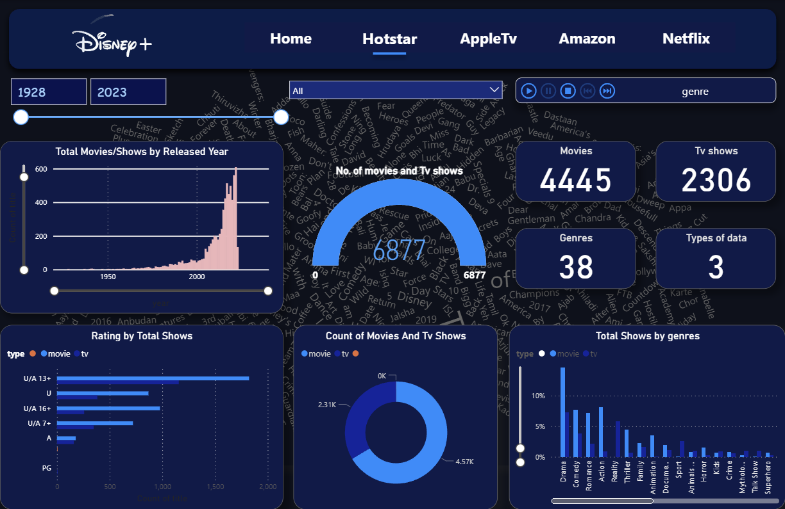

How Data Is Visualized ?
Types of Graphs
Types of Cards
Types of Filters
Shows and genre
No. of Movies and Tv shows
Movies and released Date
Rating and Movies
Counts of words used in title
Genre
Movies
Tv shows
Type of data
Genre
Dates
Type

Slide 11
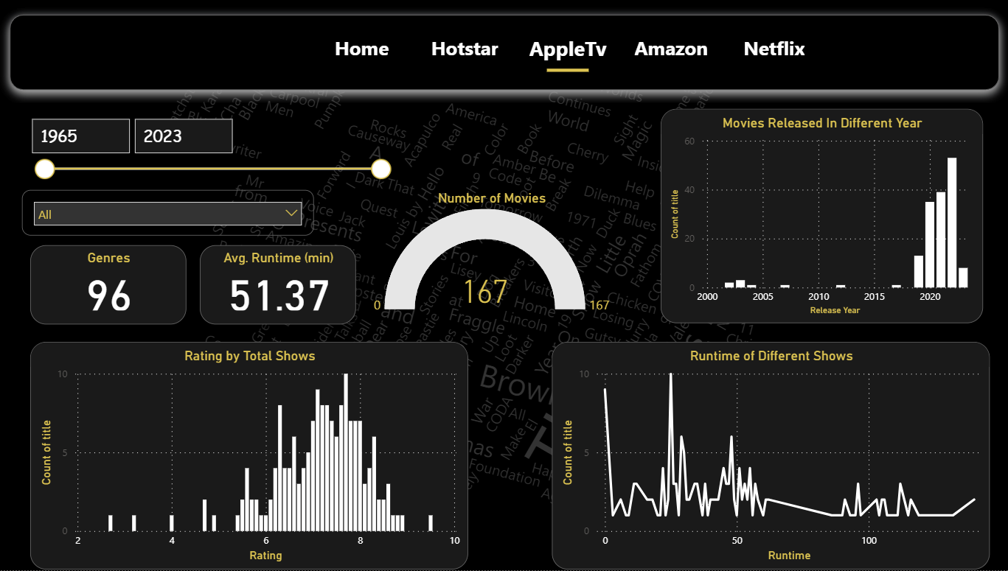
How Data Is Visualized ?
Types of Graphs
Types of Cards
Types of Filters
Runtime of Different Shows
Movies and released Date
Rating of Tv shows
Counts of words used in title
Genre
Movies
Avg. Runtime(min)
Genre
Dates

Slide 12
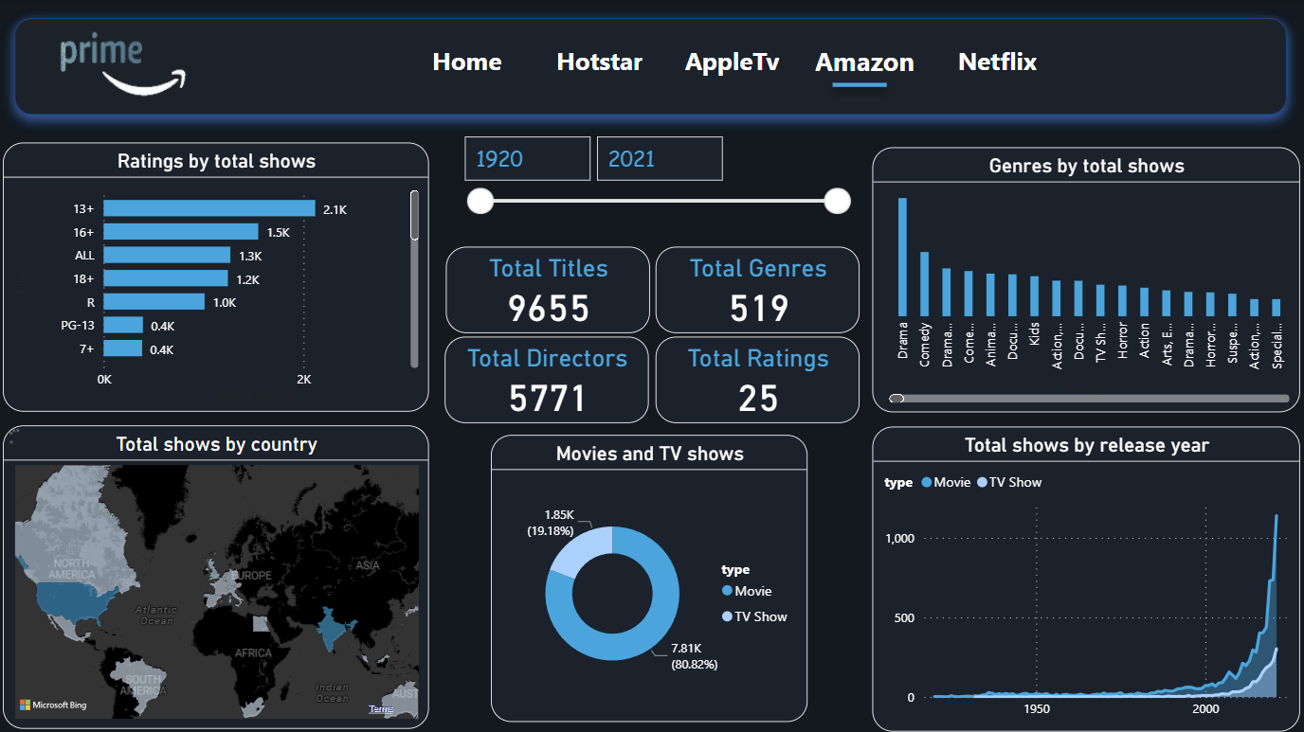
How Data Is Visualized ?
Types of Graphs
Types of Cards
Types of Filters
Movies and released Year
Total shows and Genres
Total Shows by Country
Rating of Tv shows
Counts of words used in title
Genre
Titles
Rating
Directors
Dates

Slide 13
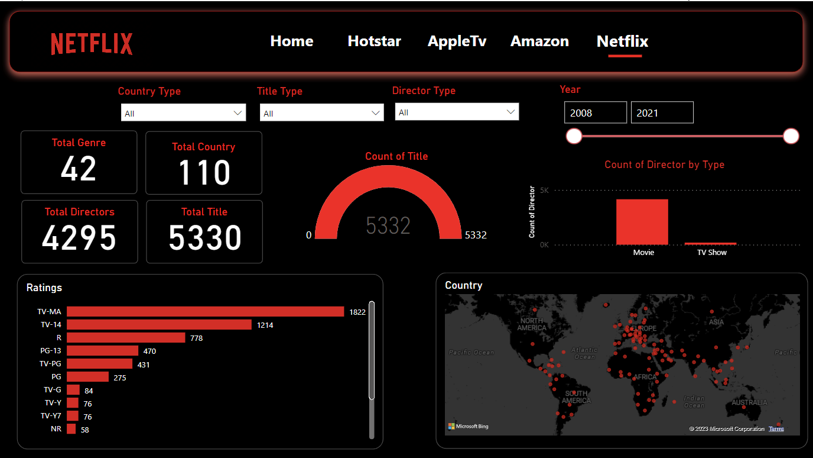
How Data Is Visualized ?
Types of Graphs
Types of Cards
Types of Filters
Movies and released Year
Total shows and Genres
Total Shows by Country
Rating of Tv shows
Counts of words used in title
Genre
Titles
Rating
Directors
Dates
Director Type
Title Type
Country Type

